Slide 1
Cache Timing Attacks on x86 and ARM Architecture
Toyin Yusuf, Nagulan Manivelan, Pragadeesh Nithyakumar

Slide 2
What are Cache Timing Attacks
A side-channel attack where the attacker analyses the time it takes to do an encryption
In the cache there is high data dependency
a cache hit takes faster than a cache miss
Secret information can be leaked by measuring the time it takes to do a hit or miss on a shared cache
Cache attacks examples: Flush and Reload, Flush and Flush
Notes:
toyin

Slide 3
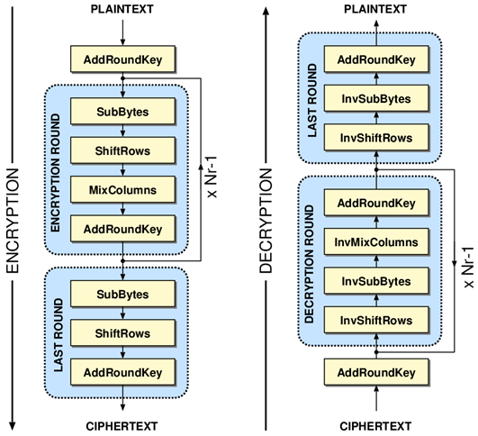
AES Encryption
Advanced Encryption Standard
Iterated cipher with symmetric key
Input: 16 byte key and 16 byte plaintext
Output: 16 byte ciphertext
128-bit key with 10 rounds, consists of these operations:
SubBytes
ShiftRows
MixColumns
AddRoundKey
Intermediate results in AES T-Tables
OpenSSL library AES library
Notes:
toyin

Slide 4
Flush And Reload Attack
The Attacker and Victim processes use a shared library
Attacker flushes a cache line where target address is located
Victim does an AES encryption
Attacker reloads the target address on the cache line and times it
If the time is short, it is a cache hit and the victim has accessed it
If the time is long, it is a cache miss and victim has not accessed it
Attacker keeps the samples (ciphertext) that were ache hits
Notes:
toyin

Slide 5
Flush and Flush
This attack does not involve accessing the cache lines, instead the attacker calculates the time taken to flush the cache.
Attacker flushes a cache line were target address is located
Victim does an AES encryption
Attacker flushes the cache line and times the time taken to flush the cache.
If the time is short, there is no data in the cache (no victim access)
If the time is long, there is data in the cache line (victim has accessed).
Attacker then saves the samples (ciphertext) that were accessed by the victim.
Notes:
toyin

Slide 6
Experiments
X86 COE System
Flush and Reload
Flush and Flush
ARM COE System
Flush and Reload
Flush and Flush

Slide 7
x86 Cache Profiling - Flush and Reload
Initialize and allocate array
Flush address of array using clflush()
Time the reload of array address using maccess()
Threshold between hit and miss determined to be 150ms
Cache line size is 64 bytes

Slide 8
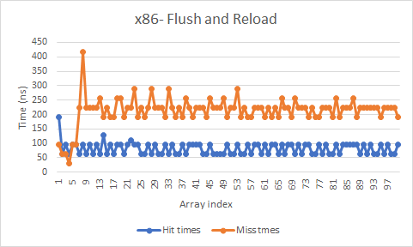
x86 Cache Profiling - Flush and Reload

Slide 9
x86 Cache Profiling - Flush and Flush
Initialize and allocate array
Flush address of array using clflush()
Time the flush operation (time to flush cache with data).
Flush the cache and time the flush operation again (time to flush cache without data.
Threshold between the time to flush cache with data and time to flush cache without data is determined to be 350

Slide 10
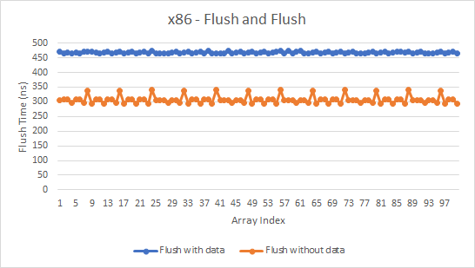
x86 Cache Profiling - Flush and Flush

Slide 11
ARM Cache Profiling - Flush and Reload
ARM cache is also profiled in the same way as x86.
The threshold is found to be 150.

Slide 12
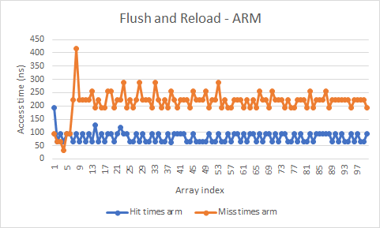
ARM Cache Profiling

Slide 13
ARM Cache Profiling - Flush and Flush
The threshold is found to be 310 for Flush and Flush.

Slide 14
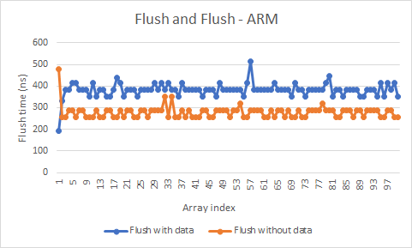
ARM Cache Profiling

Slide 15
Encryption Key Recovery
For each byte in each kept ciphertext (c_{j}, 16 bytes)
Loop through each key guess (k_{i} = 0 to 255)
Calculate s = s⁻¹[k_{i} ^ c_{i}] (s⁻¹[] is inverse of sbox)
If s > 0 and s < 16 count that this is a possible key guess
The real key values are the ones with the highest counter
We retrieve 4 key bytes in our offline_analysis.c program
Cannot recover full key
Notes:
Toyin

Slide 16
Results - Recovered Key bytes (All experiments)
Results | x86 |  | ARM
 | Flush and Reload | Flush and Flush | Flush and Reload | Flush and Flush
Threshold | 150 | 350 | 150 | 310
Recovered Key bytes | Byte1: 69 Byte2: 73 Byte3: 142 Byte4: 245 | Byte1: 48 Byte2: 204 Byte3: 230 Byte4: 7 | Byte1: 30 Byte2: 150 Byte3: 66 Byte4: 2 | Byte1: 149 Byte2: 147 Byte3: 159 Byte4: 197

